Slide 1
16.10.2025

Slide 2
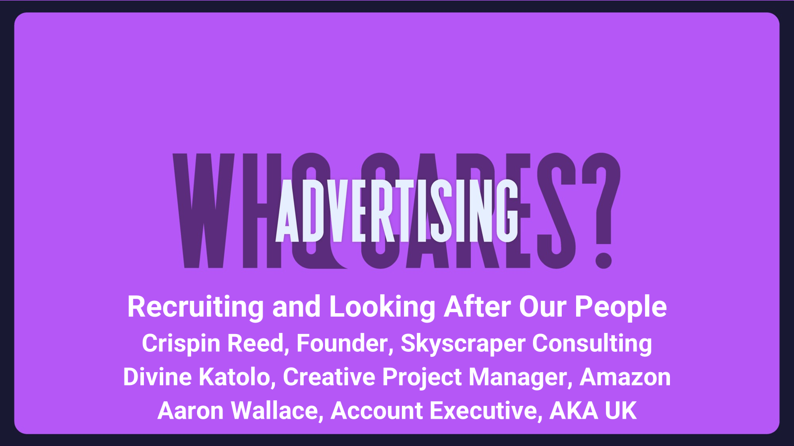
16.10.2025

Slide 3
Previously on awc…

Slide 4
“Why would I want to join an industry that bombards me with rubbish?”
Business undergraduate

Slide 5
money

Slide 6
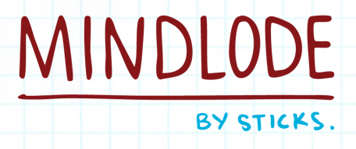

methodology
STAGE 2
Quantitative:
200 students in full time education
Online survey including segmentation questions, attitudinal scale items, ranking tasks, sector engagement checks, and two open-ended questions
Qualitative:
18 x early careers, 1-5 years
1 to 1 in depth interviews: path from school to employment
Convenience sampling approach

Slide 7
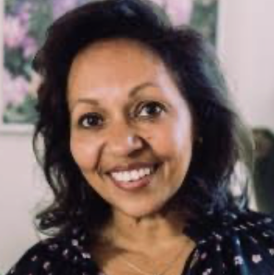
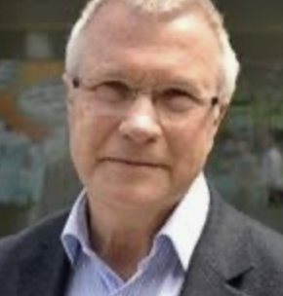
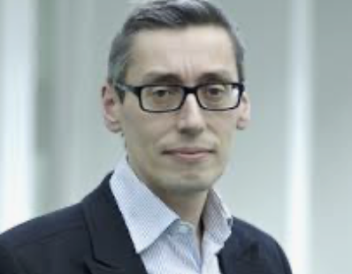
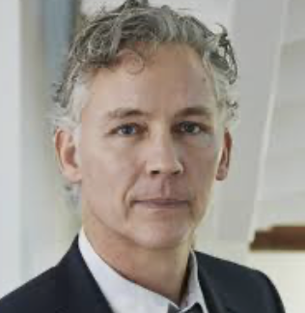
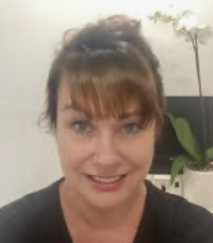
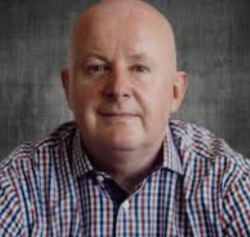
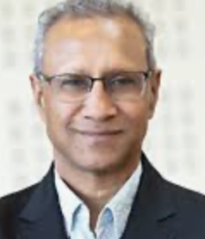

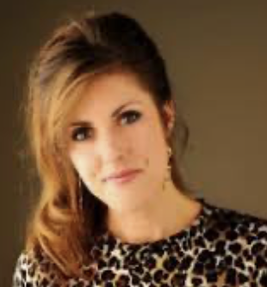
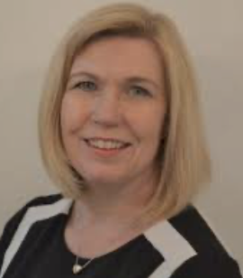
Workstream members
Jackie Almeida
Vic Davies
Gerry D’Angelo
Chris Hackley
Maxine Haigh
Kevin May
Roy Patel
Debu Purkayastha
Louise Sloper
Kellie Vincent

Slide 8
quantitative

Slide 9
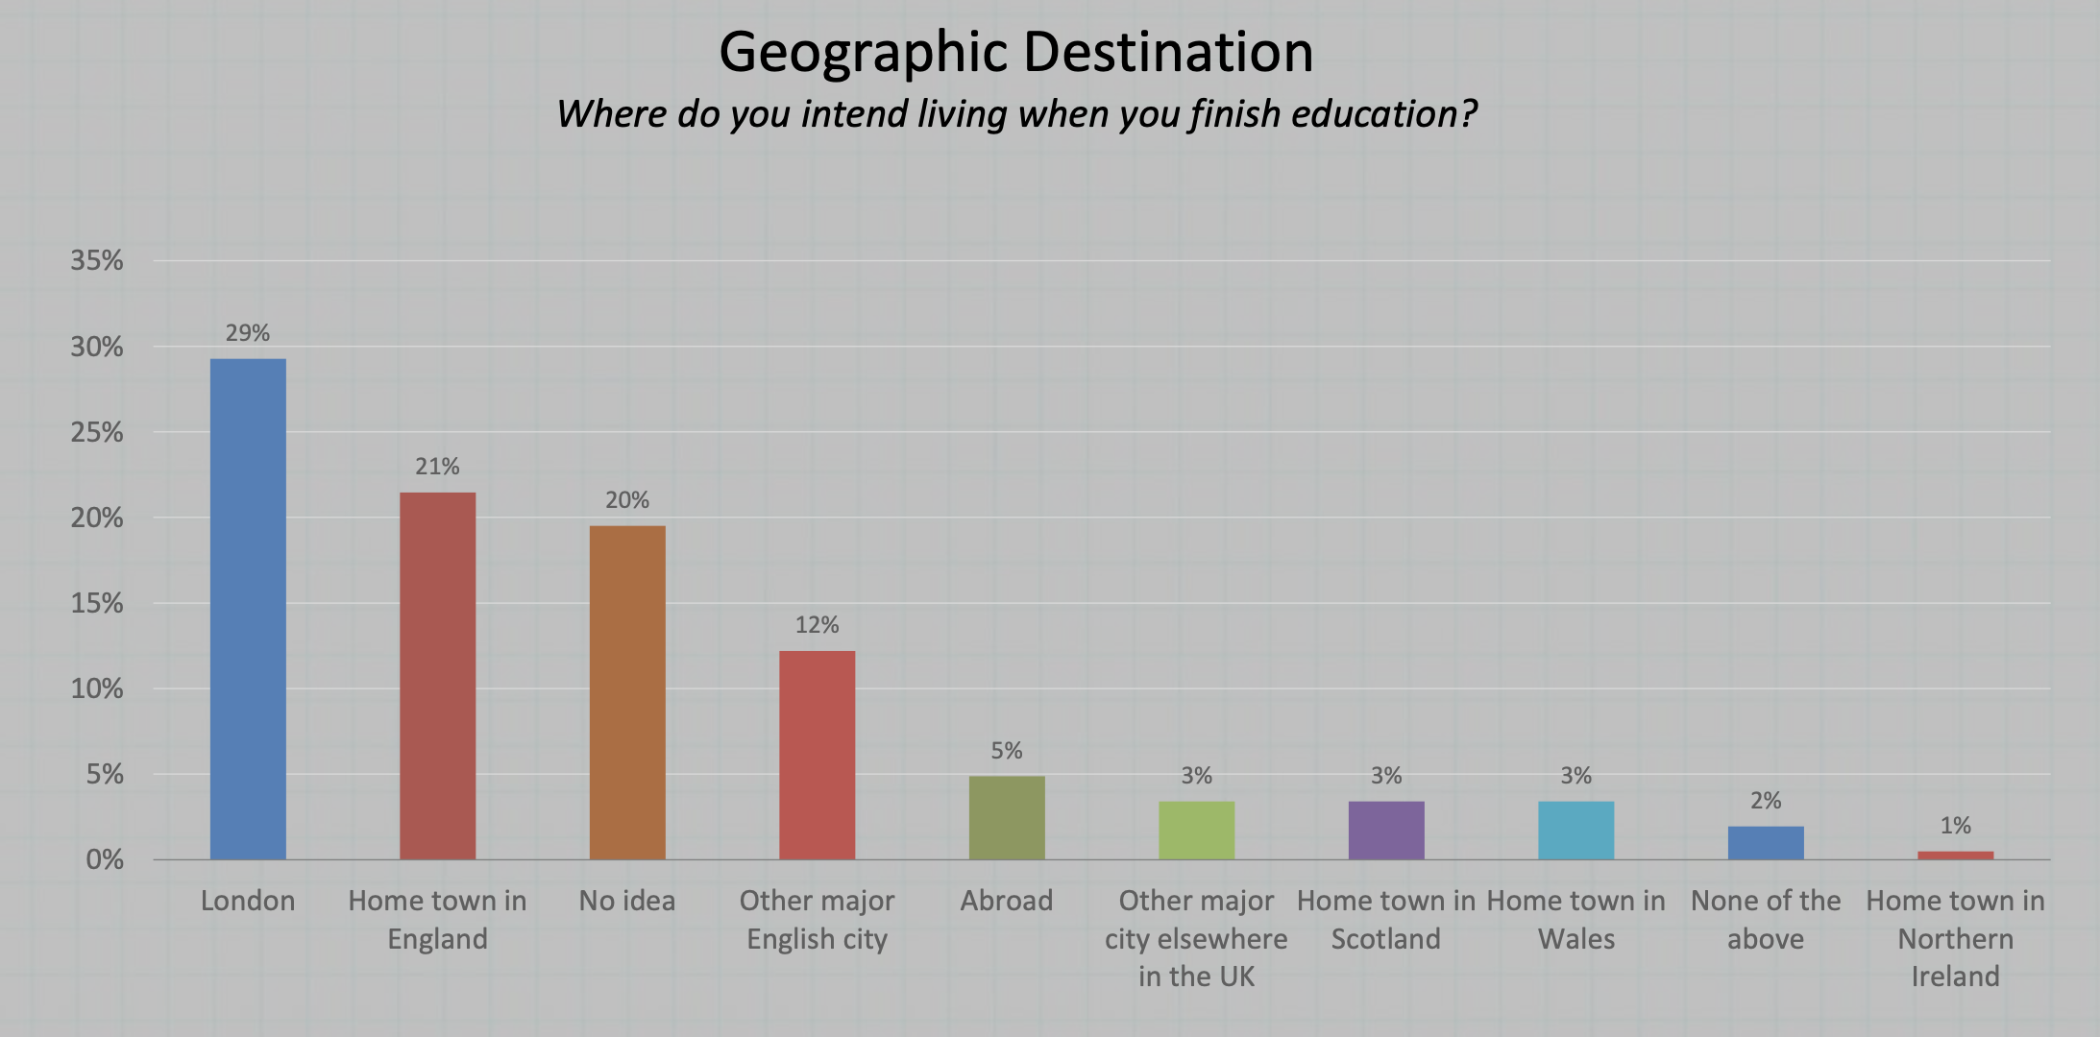

Slide 10
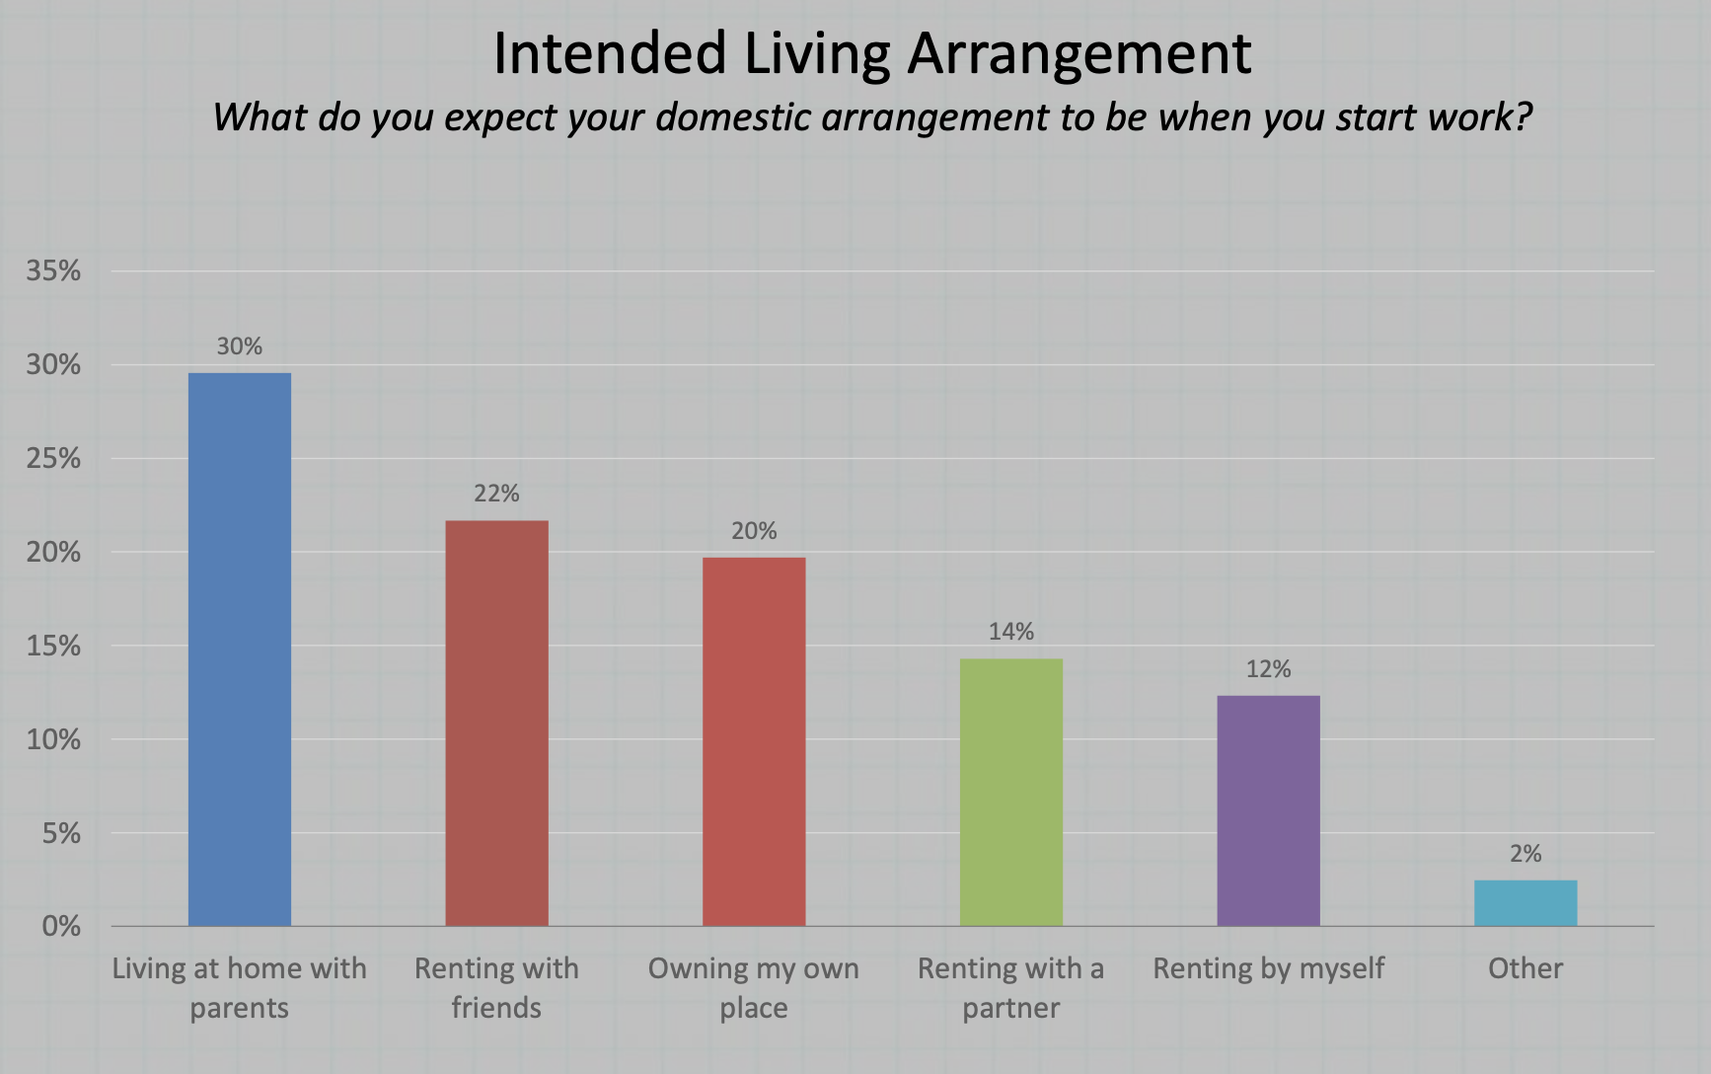

Slide 11
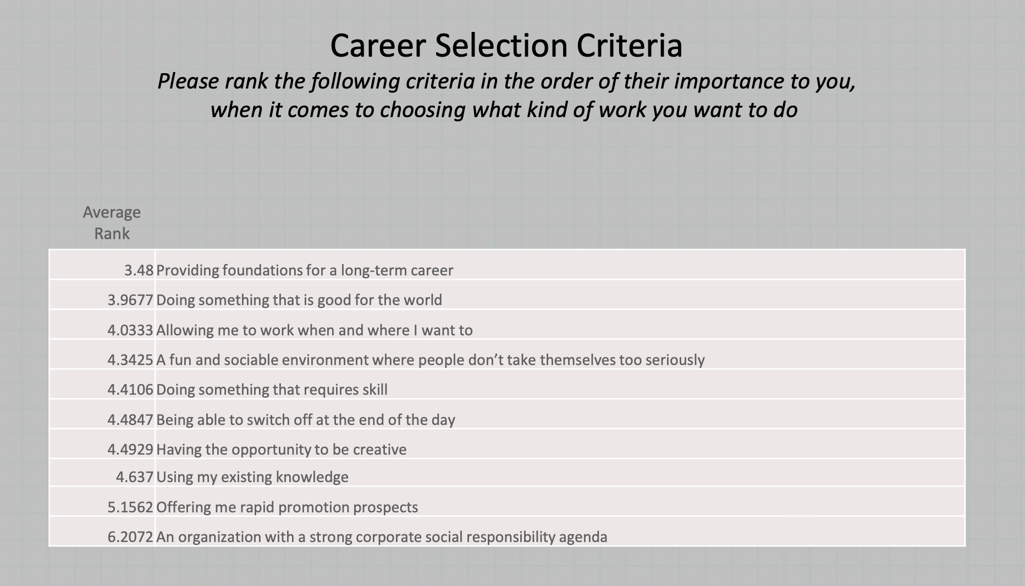

Slide 12
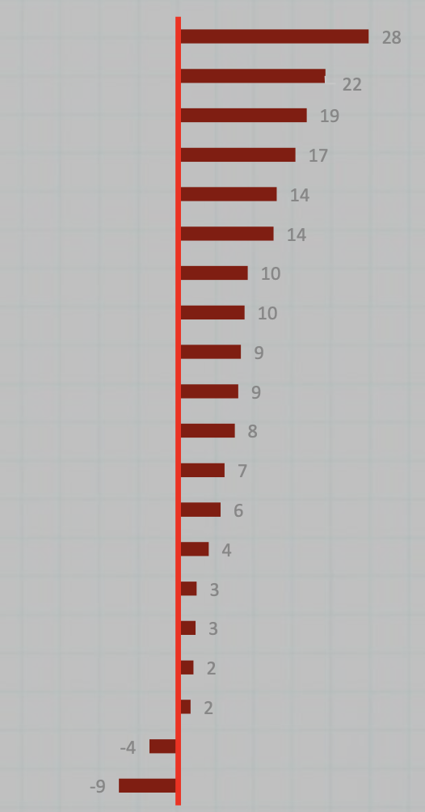
Statements ordered by level of agreement
I don’t want to ever stop learning new skills and applying them
I want to have work friends that I can have a social life with too
I wouldn’t care if nobody I knew had even heard of my job or where I work
I deserve to be successful
I expect the first few years to involve a lot of thankless graft
For people starting work now, they’re going to have to run twice as far to get half as much
I’m looking forward to settling down and starting a family
I want to do something where no two days are the same
The problem with interesting or creative jobs is that you don’t generally earn that much
I don’t expect my work to be what gives my life purpose – that comes from other stuff
While it might be nice to go into business for myself, I think I’d be too stressed about it all
You should be regularly acknowledged for your efforts even if you’re not producing results
I don’t think I could do a job unless I really believe in it and think it matters
People who make frequent mistakes should expect to get fired
I don’t like taking chances when there is a tried and tested way available
Good money and a stable job are more important to me than interesting work
I wouldn’t want to work at all if I had enough money
I want other people to wish they had my job
I doubt if my personal contribution is going to make that much of a difference
I don’t mind poor work/life balance if it means I’m being paid really well

Slide 13
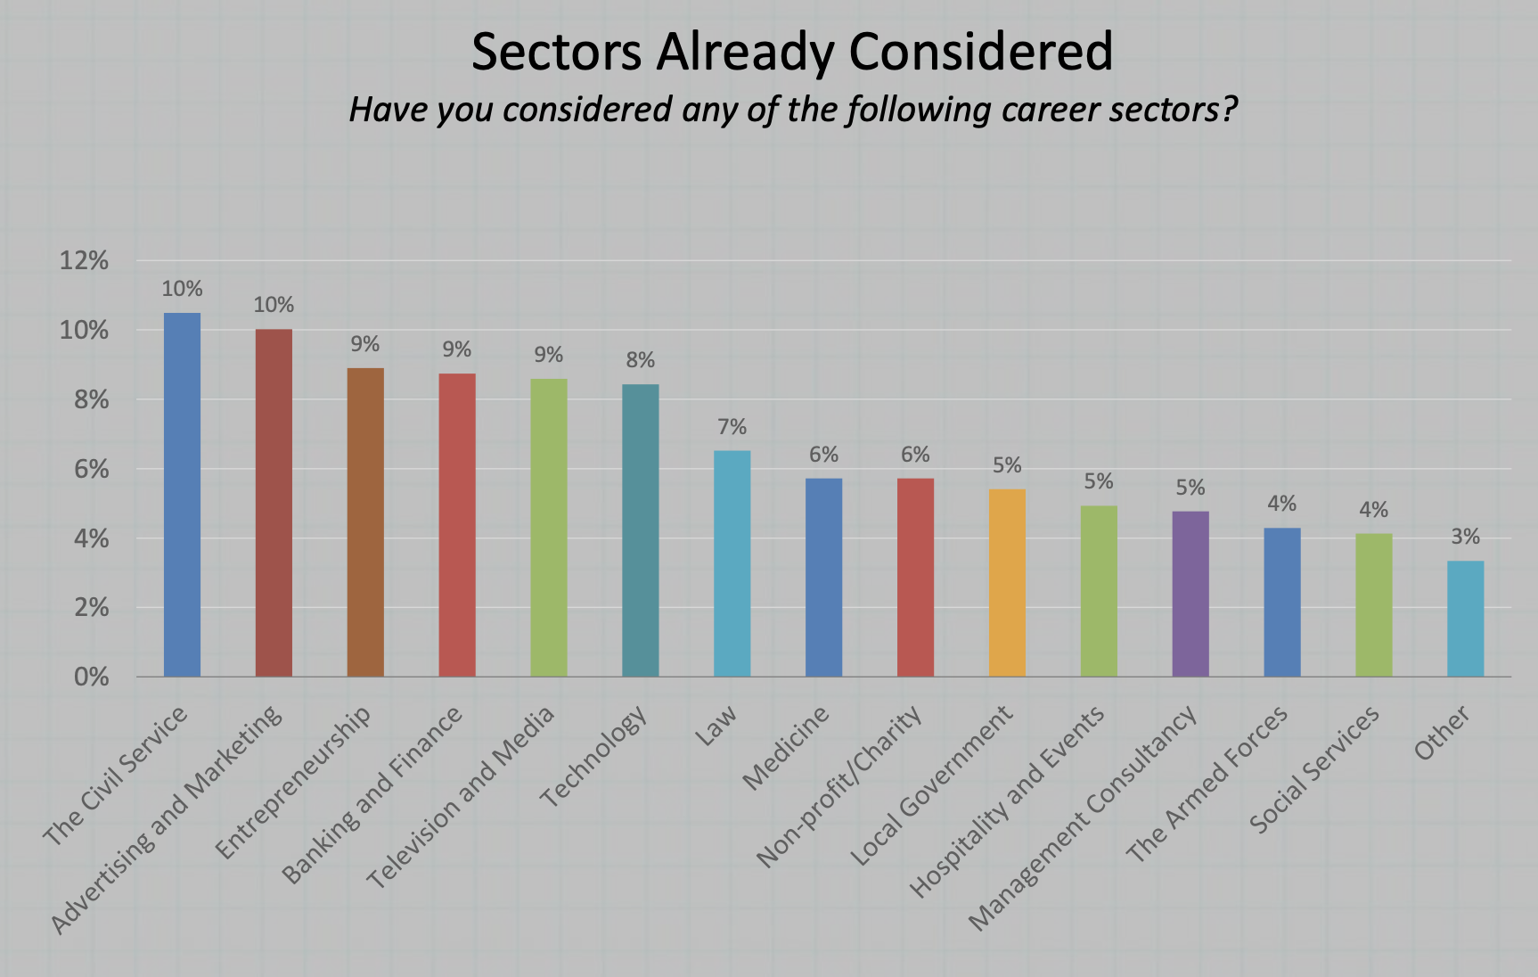

Slide 14
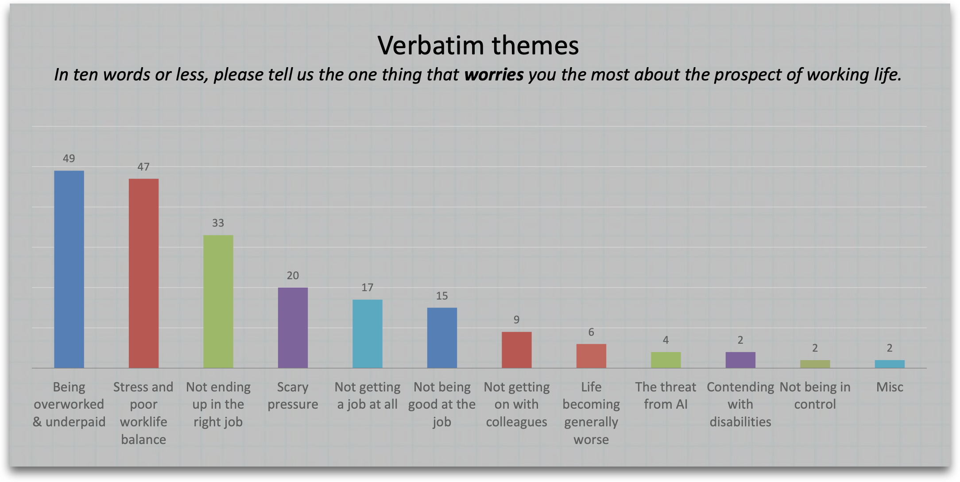

Slide 15
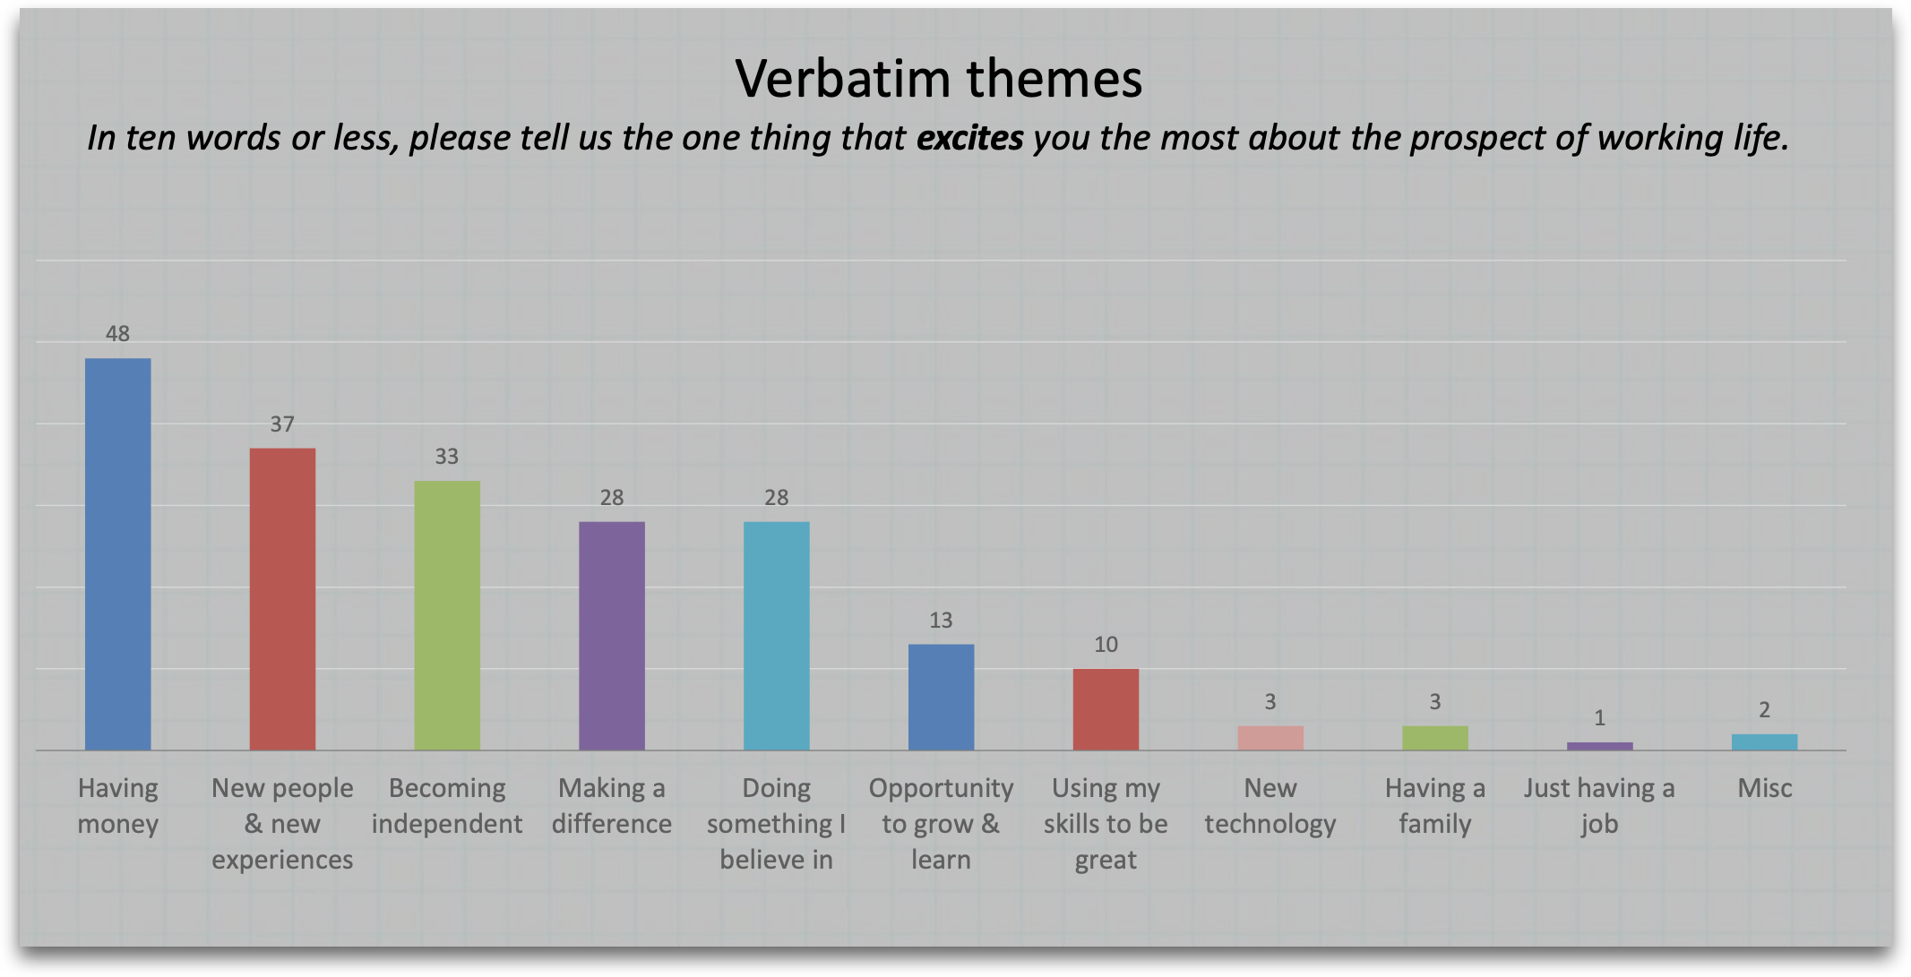

Slide 16
qualitative

Slide 17
Qualifications
Business and Economics
Maths and Psychology
Sociology
Accountancy (degree apprenticeship - after turning down optometry degree place)
Marketing and Business
Media and Communications
Foundation Art & Design
Geography
English Literature
English Literature with Creative Writing
Economics (+ Master’s in Internal Audit and Consultancy)
History (+ Master’s in Politics)
Marketing and Management (+ Master’s in International Marketing)
Politics and International Relations
French and Italian (+ Master’s in Management)
History (+ MSc in Politics and Communication)
M.Tech degree in Engineering and Management (+ Master’s in Marketing Communications and Advertising )

Slide 18
sectors
Media
Creative
Civil Service
Recruitment
Retail banking

Slide 19
money

Slide 20
money
I need to be earning £100k by 30. If advertising doesn’t offer that, we’re not looking at it
Don’t expect people to survive in London on £25k. If you want top talent, you have to pay for it.
Starting salaries and London rent are a brutal combo.
I had support from my parents.

Slide 21
skills

Slide 22
skills
I always had this balance – loved imagination and creativity but I studied business and economics
Strategy appealed because it’s about unlocking human truths
Sociology helped me to understand people’s habits and behaviours
I love talking to people – trying to turn cold calls into something positive
Media exec
Copywriter
Media exec
Recruitment exec

Slide 23
skills
What doesn’t kill you makes you better – these experiences will hold you in good stead
I built a huge amount of self-resilience
(long job search)

Slide 24
AI

Slide 25
Ai- Confidence, blind optimism or naivety?
It’s not going to be unique enough as YOU or my imagination
It’s obvious when something has been AI generated compared to humanly prepared
It’s not going to replace real creativity
It’s a tool not a threat

Slide 26
leadership

Slide 27
leadership
The difference between a good manager and a great manager is how they handle moments when I’m overwhelmed
It’s the first company I’ve worked for where I have faith in the leadership
I wouldn’t have entered the industry if it wasn’t for her
Showing vulnerability in leadership? BS. I want to see vision, focus, strength.

Slide 28
The workplace as a usp
People are fed up staring at their screens – people actually want to come in and make small talk
Create a sense of community

Slide 29
Every action has a reaction
“I’m aware being a white middle-class male is a barrier but if I’m good enough I’ll make it”

Slide 30
Advice

Slide 31
ideas
Industry wide awareness drive - variety
Greater agency presence on TikTok, Instagram
Young Professionals UK (young-professionals-uk)
Get on campus - careers fairs
Engage with ‘champions’
Engage with UCAS
Parental engagement (schools)
Times Top 100 employers
Emphasise long term opportunity
  long term employees
  long term client relationships
Branded Content

Slide 32
Opportunity (for independents?)
“Talk about storytelling, fun and lifestyle – show it’s not just suits and corporate boxes”

Slide 33
Employee generated content
“No one knows the product as well as the employees”

Slide 34
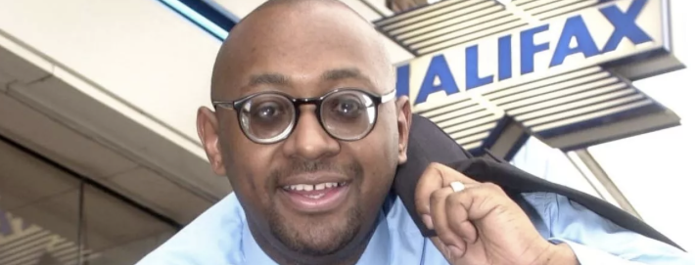

Slide 35
And finally…

Slide 36
“Make advertising glamorous again”

Slide 37
16.10.2025

