Slide 1
Trading, Transparency and Trust: A New Approach
Jenny Biggam, Owner, the7stars
Neil Harrison, Head of Media, Standard Life

Slide 2

The Landscape of Concern
Ad Fraud • Content Moderation
Quality Content • Data Privacy
Programmatic Supply Chain

Slide 3
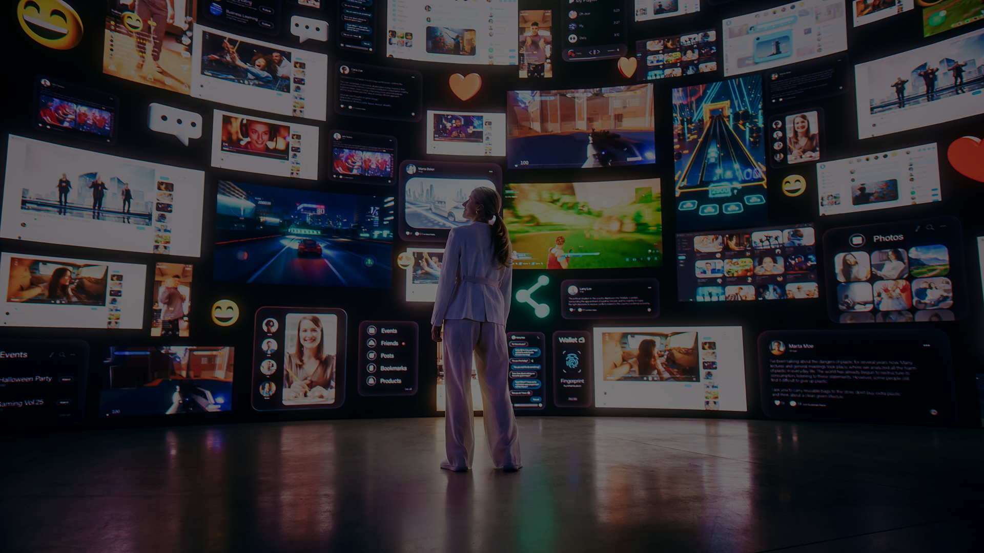
Principal Media
The Epicentre of Accountability

Slide 4
How do you feel about the practice of proprietary media?
15
12
2
Positive
Neutral
Negative
Source: ISBA Media Leaders

Slide 5
Do you think inventory media compromises an agency's ability to provide neutrality in media planning recommendations?
21
8
1
No, I still trust my agency’s planning recommendations
Yes sometimes but it’s not a big concern
Yes definitely
Source: ISBA Media Leaders

Slide 6
Do you think inventory media makes it more difficult to analyse the effectiveness of your media plan?
11
10
9
No, I am still able to analyse effectiveness adequately
Neutral
Yes this is a concern to me
Source: ISBA Media Leaders

Slide 7
If you use inventory media, what is the #1 reason you choose it?
(please select all the apply)
15
10
11
6
6
6
Cost efficiency
Improved performance
Agency pressure
Testing and experimentation
Opportunistic media buying
It delivers incremental value above existing pricing commitments
Source: ISBA Media Leaders

Slide 8

A Client Viewpoint

