Slide 1
Changing Business Models
Nick Manning, Founder Encyclomedia
Caroline Johnson, Co-Founder, The Business Model Company

Slide 2
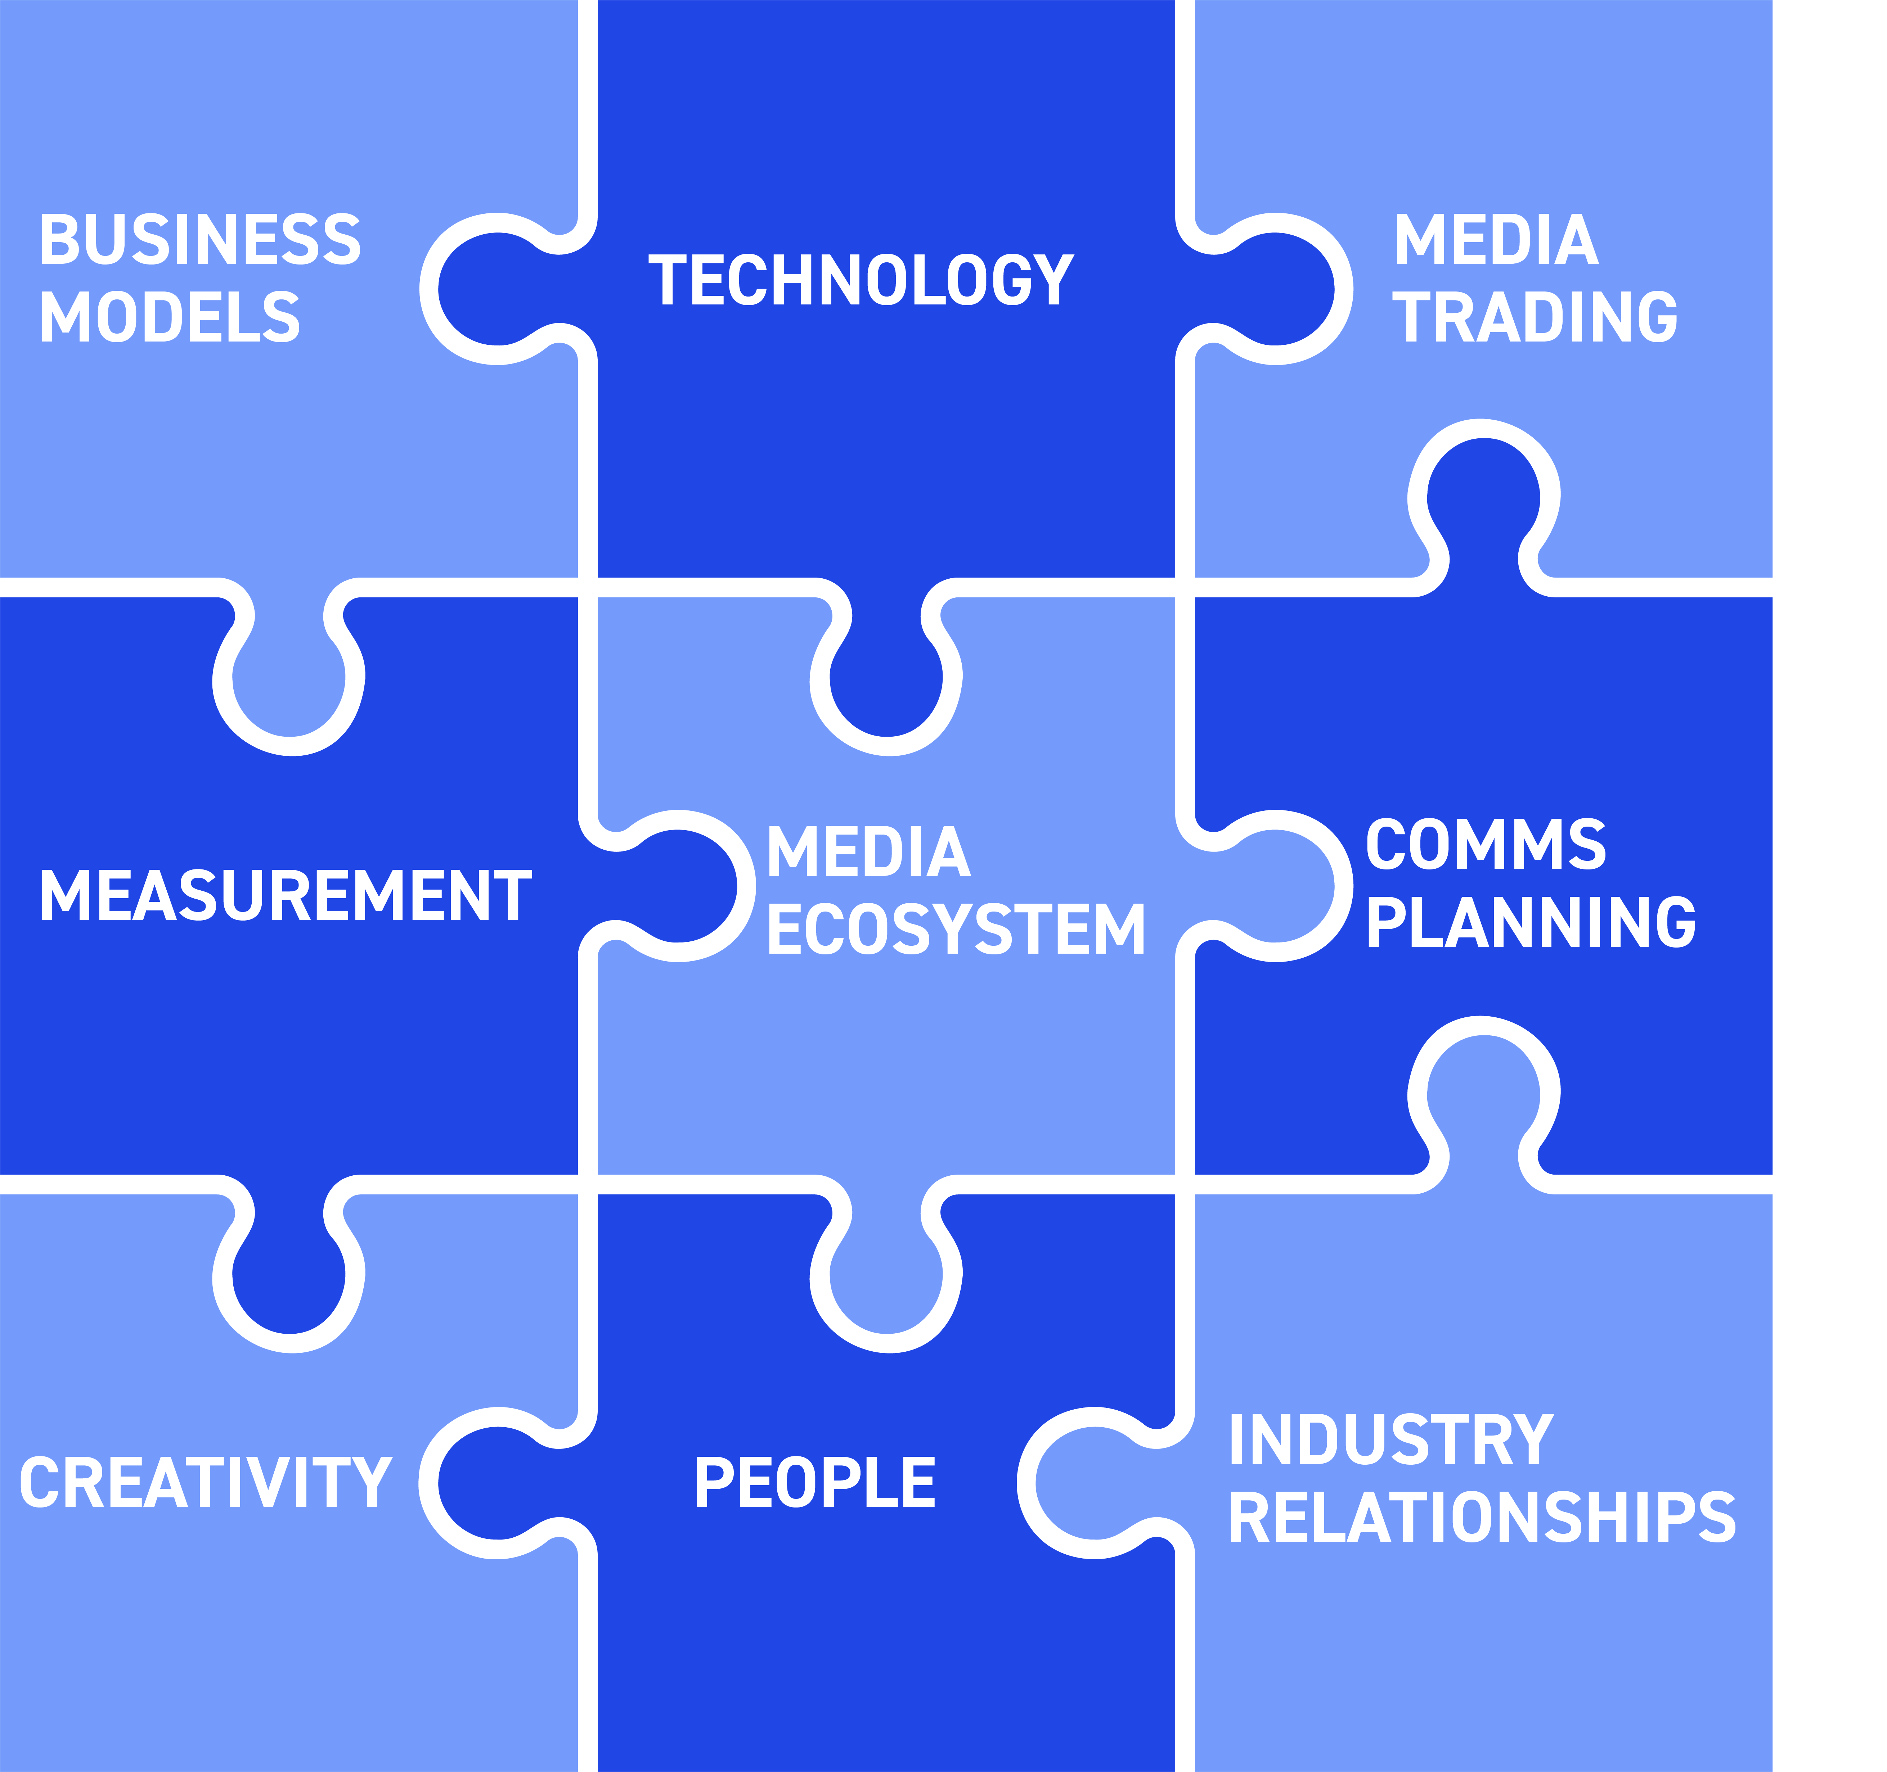
The SOLUTIONS-NEW THINKING

Slide 3
US$230 BILLION

Slide 4
50% of global ad spend goes to 5 companies ALL PRIMARILY FUNDED BY 1-2-1 ADVERTISING Most OF IT is automated MORE OF IT Will Be AI slop

Slide 5
THIS IS A CRISIS

Slide 6
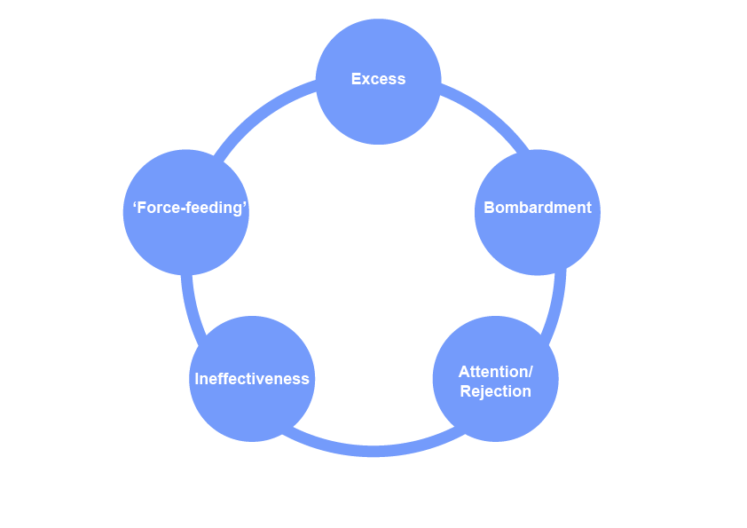
THE DOOM LOOP-PRE AI

Slide 7

ADVERTISING TODAY: A CROSS BETWEEN THIS…

Slide 8

AND THIS…

Slide 9

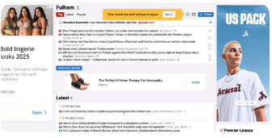



WHAT THE PUBLIC SEES

Slide 10


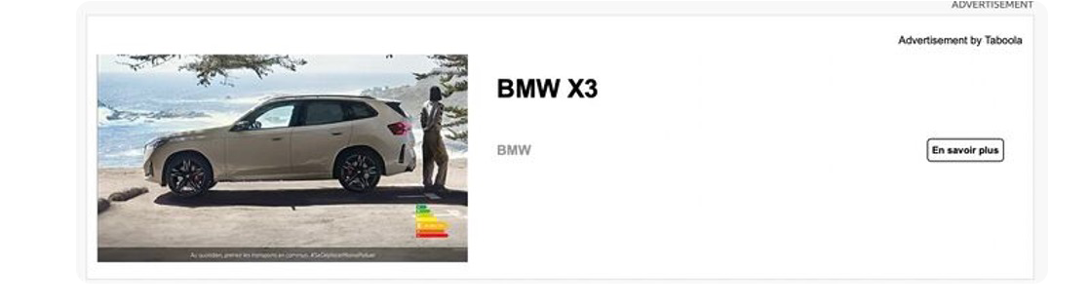

WHAT THE PUBLIC SEES

Slide 11

ANDREW TINDALL IS PARTLY RIGHT
“We’ve never spent more on advertising – it’s never done less for us”

Slide 12
ADVERTISERS HAVE TO REGAIN CONTROL WITH THE HELP OF THEIR AGENCIES

Slide 13
BUSINESS MODELS Organisation, operations, finance, culture

Slide 14


Slide 15
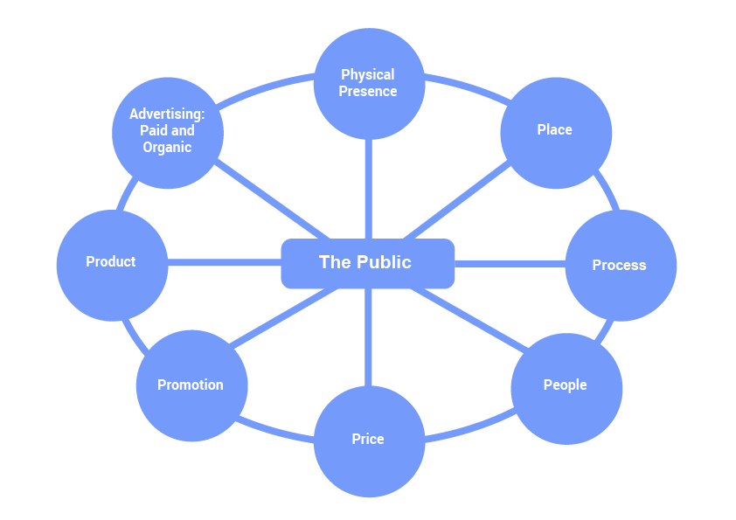
TODAY’S MARKETING IS COMPLEX AND INTERCONNECTED

Slide 16
THE OBSTACLES
Fractured organisation
Fragmented accountability
Siloed measurement
Narrow, short-term focus
Conflicting targets and Incentives
Imbalanced marketing
Waste, inefficiency, ineffectiveness
Savings-led procurement
Extractive partner relationships

Slide 17
ADVERTISERS NEED
Integrated teams with a single objective : improve the worth of the business
A new unified measurement framework that measures net profit uplift and how to get it
Experienced and expert agencies that help them achieve this

Slide 18

ORGANISATION AND OPERATIONS
People-centred
Strategy and
creativity
Effectiveness
Integration
Continuous curation and institutional learning
Technology innovation
Zero inefficiency

Slide 19
AGENCIES

Slide 20



Business model ecosystem
Create Value
Positioning
Proposition
Brands | Advertisers
Commercial
Partners
Commercial
Models
Operating
Systems
Capture Value
Deliver Value

Slide 21





future industry model:
Client-centric
Create Value
Client
Challenges
Commercial
Partners
Value
Drivers
Commercial Transparency
New
Front Doors
Product and Platform
Commercial
Models
Commercial Alignment
Technology Integration
Operating
Systems
Capture Value
Deliver Value

Slide 22

THE IMPERATIVES: CREATE VALUE
Voice of the public
Markets, audiences, messaging, channels
Integrated expertise
Strategic and creative pacemakers
Drive effectiveness
Budget setting, attention, cut-through
Paid & organic channels
Client guardian: reputation, data, cyber, IP
Technology experts, integration, engineering
Frameworks, roadmaps, playbooks
Analytics innovation

Slide 23
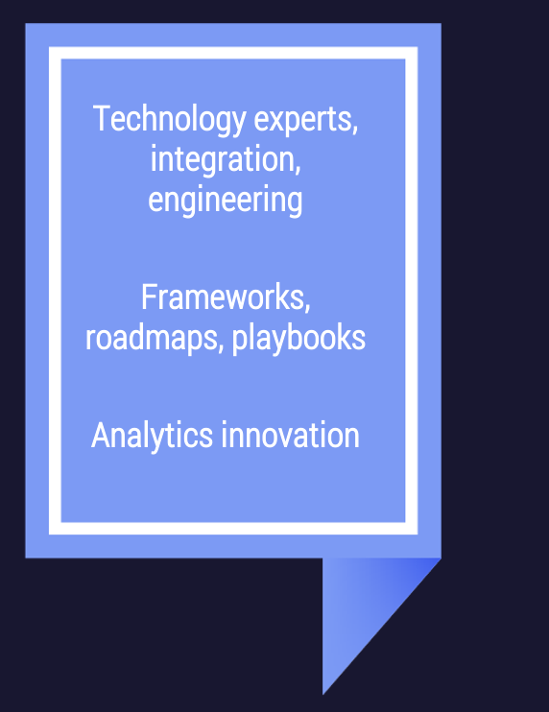
THE IMPERATIVES: DELIVER VALUE

Slide 24

THE IMPERATIVES: CAPTURE VALUE
Move away from time-based charging
New revenue streams
New products and services, charged separately
‘Full fat’ transparency in data, money, technology, IP, working practices
Co-investment
Base remuneration plus rewards vs net profit uplift
Maximise efficiency: minimise costs

Slide 25


business model
Cultural transformation
Create Value
New
Language
SERVICE TO VALUE
Culture
Behaviour Leadership
Commercial
Alignment
TIME TO OUTCOME
New Operating
Systems
MORE TO LESS
Capture Value
Deliver Value

Slide 26

NAVIGATING COMPLEXITY AS COMMERCIAL PARTNERS
from
to
Complex
Opaque
Compensated around the edges
Simplified
Transparent
Compensated on value created
26
#P

Slide 27
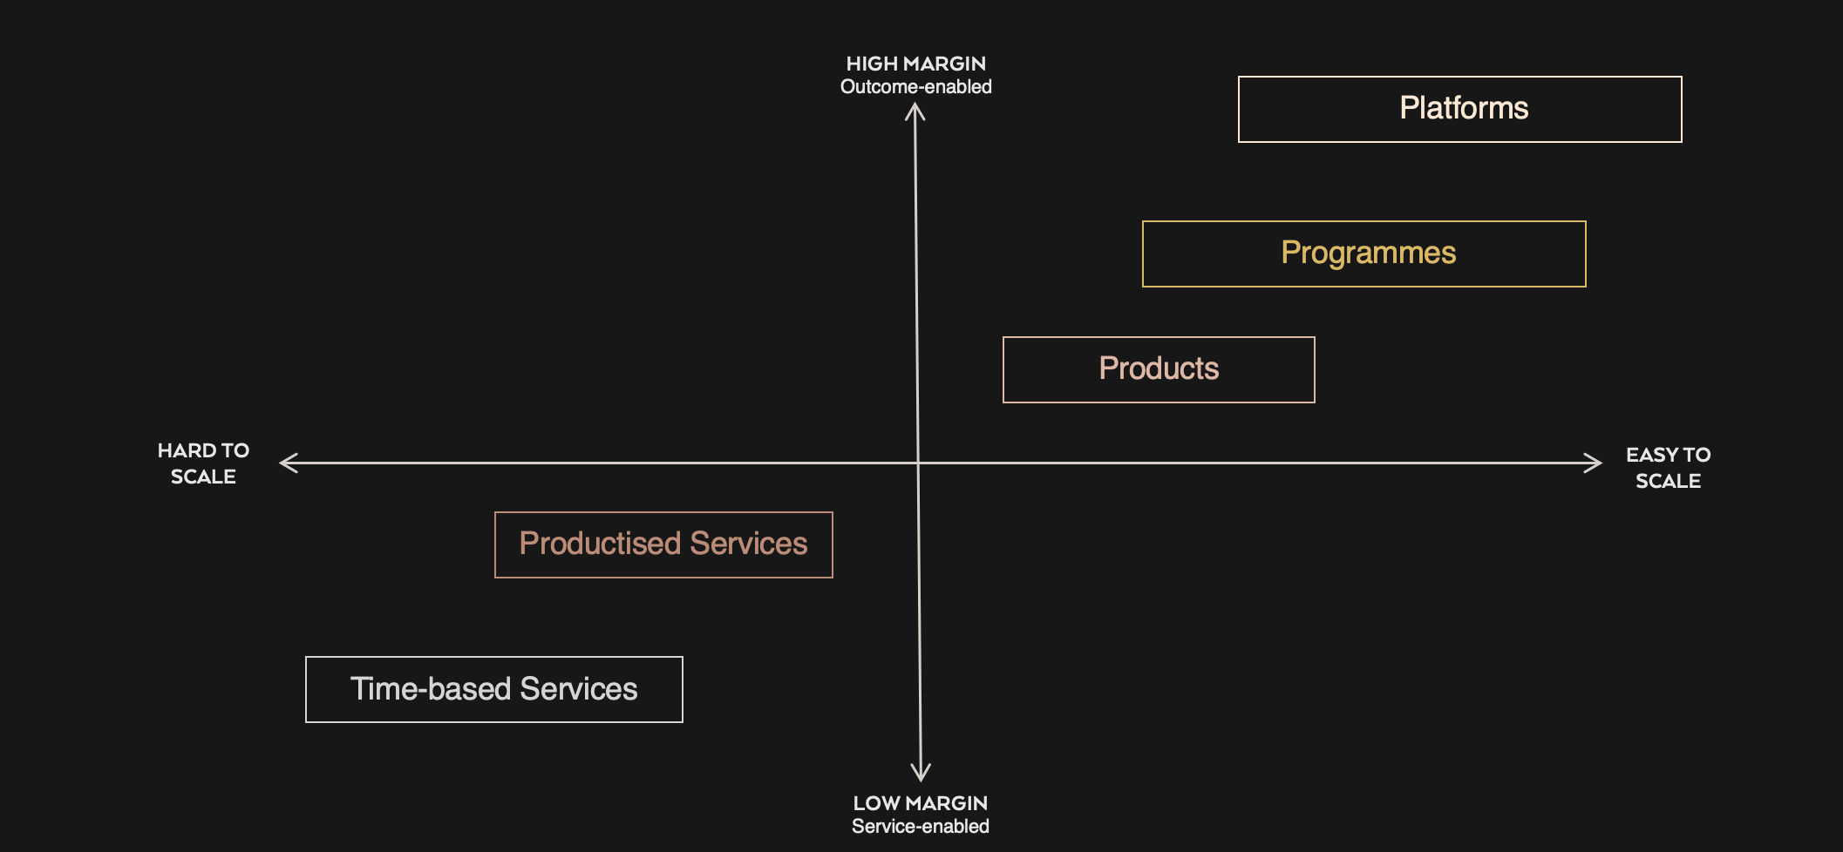
THE AGENCY OPERATING SYSTEM HAS TO TRACK THE TRANSITIONS
You need to be here
You are here
Notes:
With the audience we have today all of you will require, if you have not already, operating in the top right

Slide 28
BUSINESS MODEL CHANGE IS NECESSARY BUT NOT SUFFICIENT

