Slide 1
The Future of Comms Planning
Sally Weavers, Co-Founder, Craft Media
Pippa Glucklich, CEO, Electric Glue

Slide 2
WHO CARES ABOUT COMMS PLANNING?

Slide 3

‘I’m given a vague brief and asked to come up with something by the morning’
‘It’s not unusual to not see the creative work before a live date’
‘I now talk about media pipes more than ideas ’
‘I sometimes can’t see my strategy in the plan that is delivered’
Notes:
Will let you add the self-deprecating strategy quote!! B&W, soft focus and much chin scratching was the start point though…

Slide 4
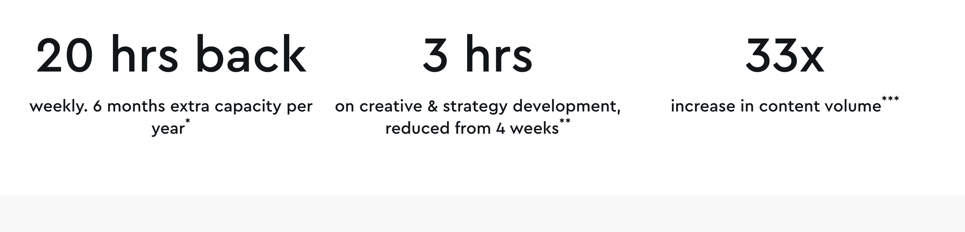
And Now possible In the blink of an eye….
Notes:
Couldn’t find the yoga reference in the video but there’s plenty we can grab from to prove our point!

Slide 5

What is the VTR?
Can we have it as a 6 secs?
The branding needs to be more obvious earlier on
Notes:
Do we have quotes to add here or are we inventing??

Slide 6
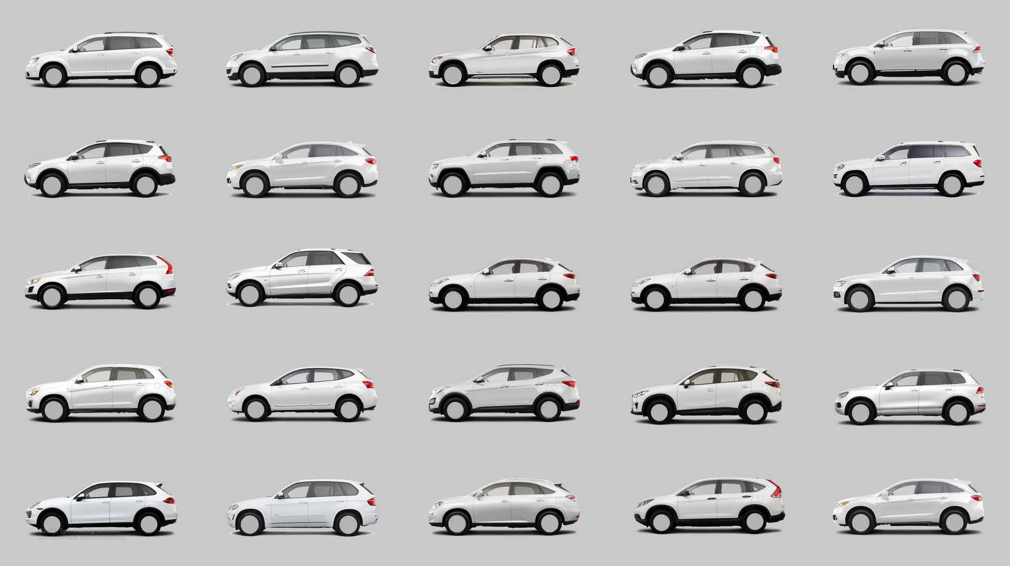
ARE WE REALLY OK WITH AIMING FOR AVERAGE?
Notes:
From The Age of Average: https://www.alexmurrell.co.uk/articles/the-age-of-average

Slide 7

LUNCH?
Notes:
Is this AI?? I can’t even tell any more… Thought it looked nice even if the negroni was a tad watery.

Slide 8

Notes:
Opportunity in tech / AI – thought I’d try to use something real rather than a crap clip art of devices. This is KITKAT’s AI campaign – ‘AI made this so we could have a break’

Slide 9
If culture is drowning us in a rising ride of digital effluent, the long-term solution is obvious, but not easy: sort out the damn plumbing. Fix the ecosystem. Demand better. But in the short term, the most radical move is the simplest: refuse to contribute to the cavalcade of crap.
Katrina Stirton-Dodd, Trends Editor Contagious, October 2025
Notes:
This was in this week’s Contagious newsletter which I thought was PERFECT and even mentions the plumbing

Slide 10

THE IDEA
Notes:
Admittedly a light bulb is an overused analogy for an idea but just thought it linked with the APG visuals nicely too!

Slide 11

WHAT IF…?

Slide 12




Slide 13
ESTABLISHING THE “MEDIA PLANNING GROUP”
How it will work
Leans into existing APG infrastructure
Independent committee
Annual training programme
Noisy Thinking for media
Bi-annual Awards
Maybe even our own book…
What we need
Membership is for individuals, we need agencies to support and invest
Willing committee members
Get clients involved
Backing of the press

